Slide 1

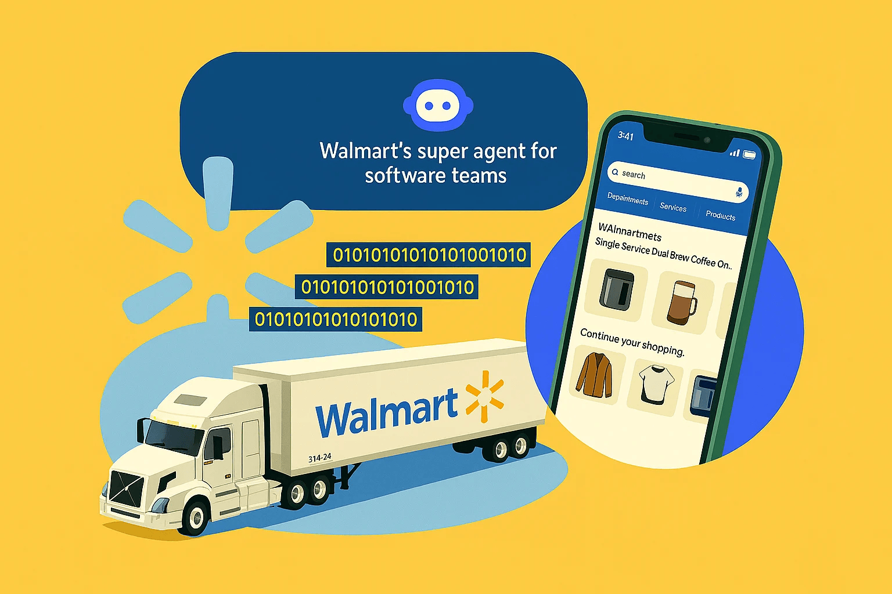
AI Agents Exception Detection
Veronica Dinh, Michaela Dennis,
Santhosh Prathik Kasam, Labeeb Ahmed

Slide 2
Presentation Outline
Data EDA
Exception Detection
AI Agent Architecture
Stakeholder
Dashboard
Business Context & Objective
Text
Text
Text
Text
Text

Slide 3
Markdown Performance Exceptions
Walmart analysts need to identify when markdown periods are not producing expected sales results.
Markdowns are intended to support sales and clear inventory, but some markdown-active weeks may not.
Reviewing stores, weeks, departments, and external factors manually can be time-consuming.
Key problem:
How can we automatically flag markdown-active store-weeks where actual sales fall below expected performance?
Business Problem:

Slide 4
Objective:
Build an AI-assisted exception detection system that identifies underperforming markdown periods and explains possible contributing factors.
Business impact:
Final goal:
Help analysts decide which markdown periods require further review.
Area | Value
Faster detection | Flag unusual markdown weeks earlier
Better prioritization | Focus analysts on the most important exceptions
Improved decisions | Support future markdown planning
Explainability | Show supporting evidence behind each flagged case

Slide 5
Data & Key Features Overview
Feature | Meaning
Weekly_Sales | Sales for a store-department-week
Store | Store ID
Dept | Department ID
Date | Week date
MarkDown1–5 | Recorded markdown variables
IsHoliday | Holiday week indicator
Temperature | Local temperature
Fuel_Price | Fuel cost
CPI | Consumer price index
Unemployment | Unemployment rate
Type | Store type A/B/C
Size | Store size
Item | Description
Dataset | Walmart Store Sales Forecasting
Level of raw data | Store × Department × Week
Analysis level | Store × Department × Week
Rows | 421,570
Stores | 45 ( Type A: 22, Type B: 17, Type C: 6)
Departments | 81 (Department 1-81)
Time period | Feb 05, 2010 – Oct 26, 2012
Weeks | 143
Main outcome | Weekly Sales
Notes:
train.csv (5) columns, features.csv (12), stores.csv (3) → 16 unique columns after merging
Breakdown of the 16 columns
Identifiers: Store, Dept, Date (3)
Target variable: Weekly_Sales (1)
Store characteristics: Type, Size (2)
Markdown variables: MarkDown1–5 (5)
External factors: Temperature, Fuel_Price, CPI, Unemployment (4)
Holiday indicator: IsHoliday (1)

Slide 6
Data Engineering
1. Data Integration
2. Data Cleaning
Merged 3 datasets: train, features, stores
Joined datasets using Store and Date identifiers
Checked missing values and duplicates
Verified date formats and data consistency
3. Data Aggregation
4. Feature Engineering
Summed department sales by store/week
Aligned sales with store-level markdown data
Created markdown indicators and totals
Created historical sales averages
Notes:
We started by combining three Walmart datasets using store and date identifiers. Next, we checked missing values and data consistency. We then aggregated department sales into store-level weekly sales to match the markdown information. Finally, we created additional features, including markdown indicators and historical sales averages, to prepare the data for anomaly detection.

Slide 7
Data Issues & Challenges
Missing Markdown Data: Approximately 64–75% of store-week records lack individual markdown values; missing does not necessarily mean zero.
Limited Markdown Granularity: Markdown data is recorded at the store-week level, not by department or product.
Encoded Store & Department IDs: Publicly inferred mappings are available, but not officially verified by Walmart.
Missing Business Context: No inventory levels, customer feedback, competitor data, or exact discount rates.
Historical Data: Sales cover 2010–2012, requiring time-aligned external evidence for RAG.
Exception Validation: The preliminary 10% threshold requires further testing against historical forecasting errors.
Our Approach: Use historical sales for forecasting, document mapping uncertainty, prioritize evidence-supported exceptions, and complete one end-to-end business investigation.

Slide 8
Key EDA Findings
Explored historical Walmart sales data to identify:
Weekly Sales Trends (2010–2012)
Top 10 Departments by Total Sales
Markdown Data Availability & Missingness
Department-Level Sales Volatility

Slide 9
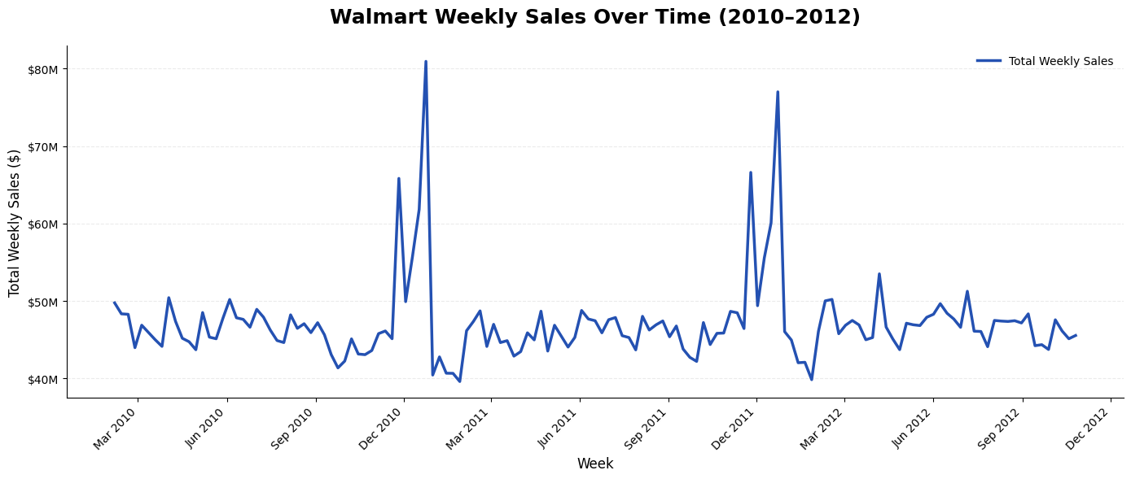
EDA 1: Overall weekly sales trends and holiday patterns
Notes:
Weekly sales remain relatively stable throughout the year, with noticeable spikes during major holiday periods

Slide 10
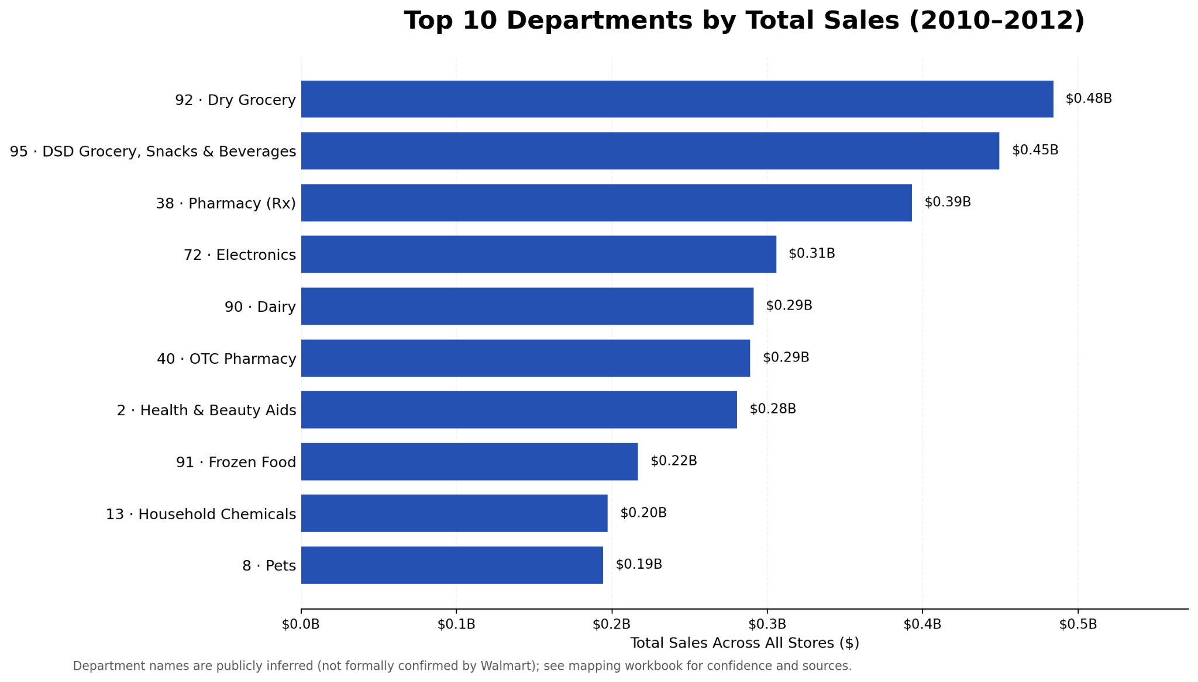
EDA 2: Top revenue-generating departments
Notes:
Grocery, pharmacy, and electronics departments contribute the highest total sales, highlighting differences in sales performance across departments.

Slide 11
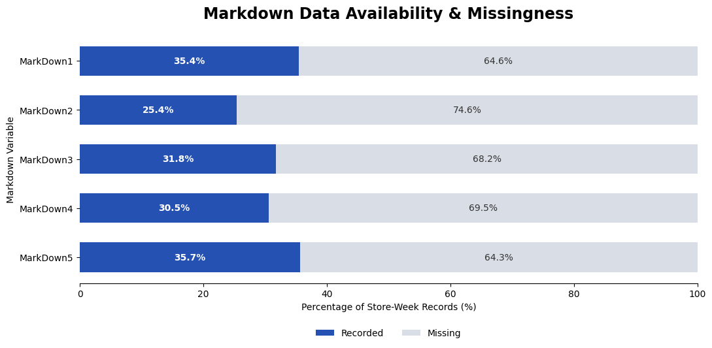
EDA 3: Markdown data availability and missingness
Notes:
Markdown data is missing in approximately 64–75% of store-week records. Historical sales can still be used to predict expected sales, while weeks with recorded markdown information can be prioritized for further investigation.

Slide 12
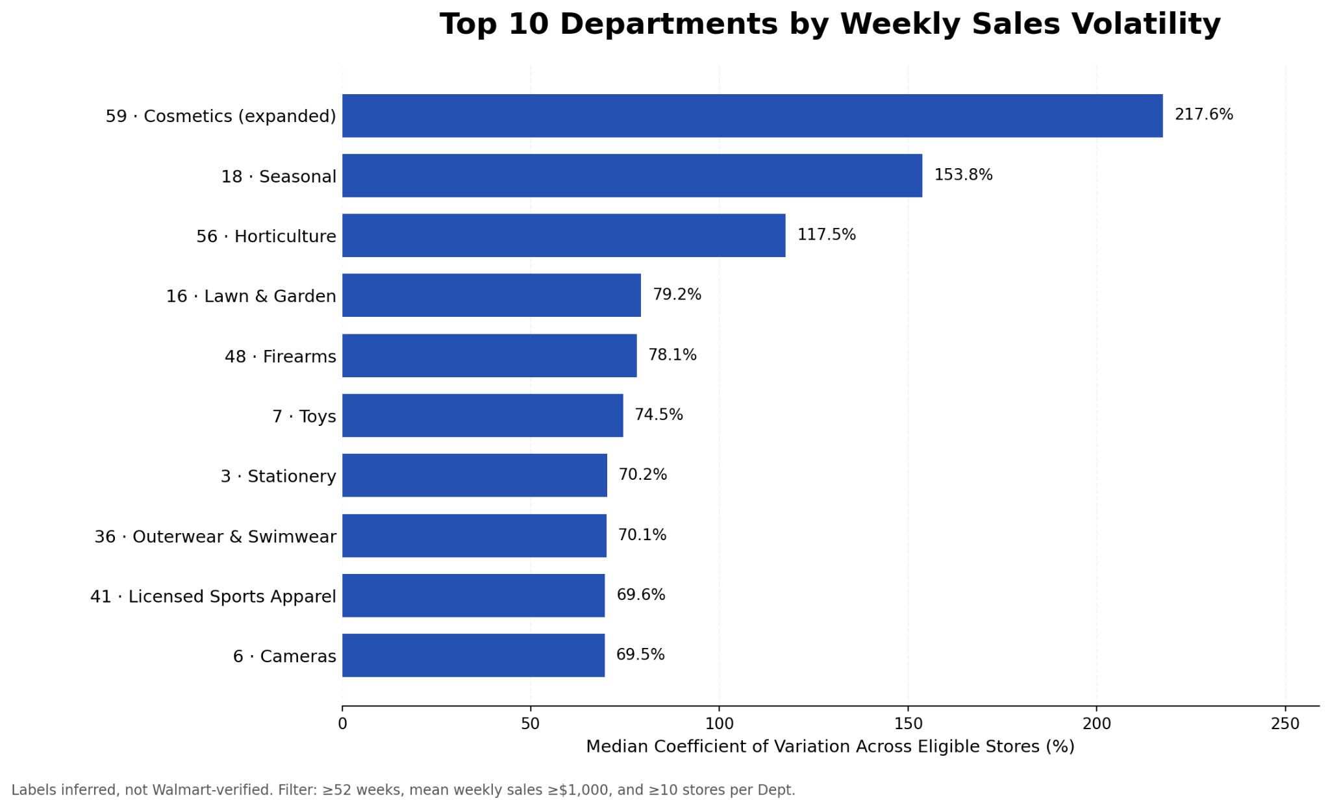
EDA 4: Department-level sales volatility
Notes:
Weekly sales fluctuate more in some departments, especially cosmetics and seasonal products, suggesting that these differences should be considered when identifying unusual sales patterns.

Slide 13
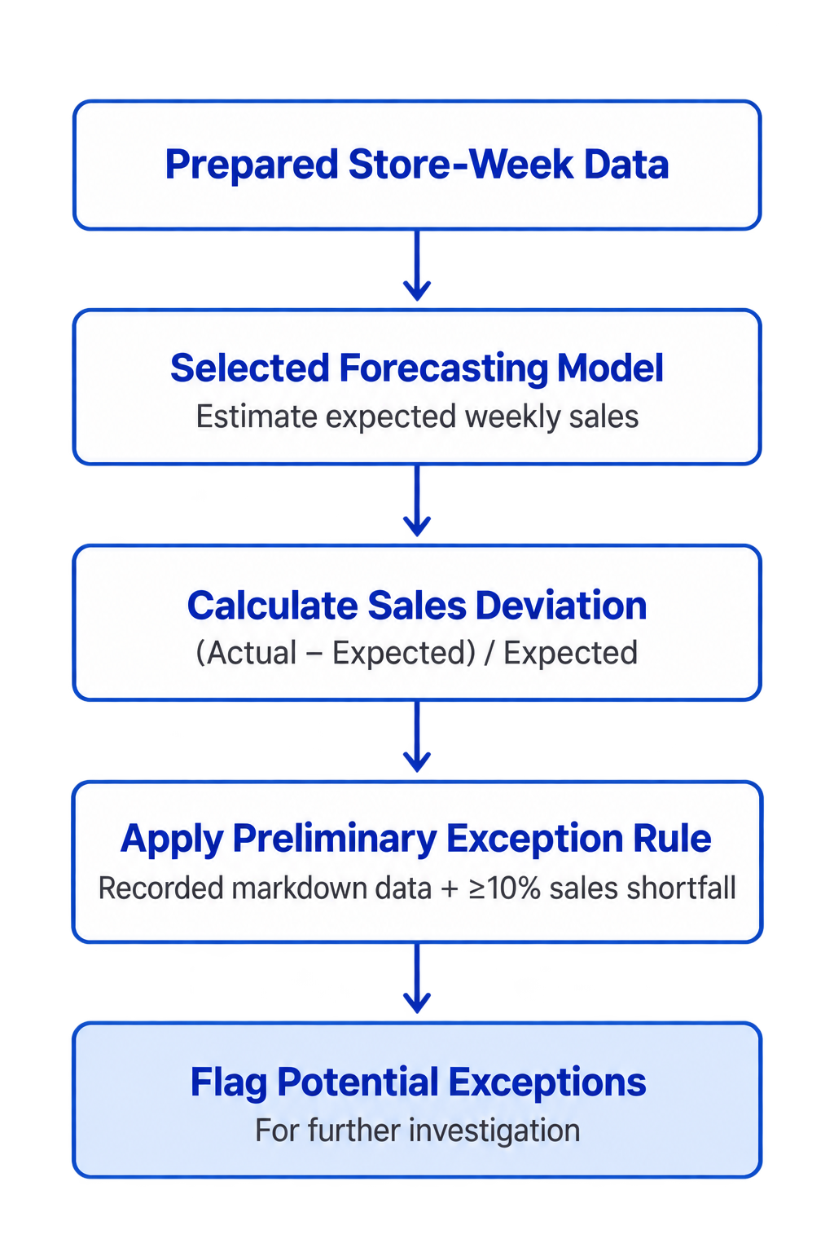
Exception Detection Methodology

Slide 14
Anomaly Detection
Supervised Forecasting-Based Anomaly Detection
Extra Trees Regression + Rule-Based Screening | Store × Department × Week

Slide 15
Forecasting Model Performance
Rank | Model | WAPE | MAE
1 | XGBoost | 7.28% | $1,194
2 | Extra Trees | 7.60% | $1,247
3 | LightGBM | 7.63% | $1,251
4 | Random Forest | 7.72% | $1,266
5 | Ridge Regression | 11.02% | $1,807
6 | 8-Week Moving Average | 11.63% | $1,907
Model | Validation 1 | Validation 2 | Validation 3
Extra Trees | 12.16% | 9.57% | 8.03%
XGBoost | 13.03% | 10.00% | 7.90%
LightGBM | 14.14% | 10.20% | 8.19%
Random Forest | 12.71% | 9.84% | 8.11%
Ridge Regression | 21.95% | 16.30% | 12.37%
8-Week Moving Average | 25.84% | 12.12% | 10.46%
* Chronological Validation WAPE
* Store × Department × Week | July 20–Oct 26, 2012 | N = 42,052
Extra Trees: Best average validation WAPE (9.92%).
XGBoost: Lowest final-test error (7.28% WAPE; $1,194 MAE).
→ Preliminary Selection: Extra Trees (based on validation performance).
Notes:
To identify the most suitable forecasting model for our Walmart exception detection project, we compared six methods: Random Forest, LightGBM, Ridge Regression, XGBoost, Extra Trees, and an 8-week moving average as our baseline. We compared six forecasting methods across four categories. First, we used the 8-week moving average as a simple historical baseline. Ridge Regression provided a linear benchmark, while Random Forest and Extra Trees allowed us to capture more complex sales patterns. Finally, XGBoost and LightGBM used boosting techniques to improve predictions.
We evaluated these models using three chronological validation periods and a separate final test period. We used two evaluation metrics: WAPE, which measures prediction error as a percentage of total actual sales, and MAE, which measures the average prediction error in dollars.
Looking at our validation results, Extra Trees achieved the lowest average WAPE of 9.92% and performed best in two out of three validation periods. This suggests that Extra Trees provided the most consistent forecasting performance under our evaluation criteria.
On the final test, XGBoost achieved the lowest prediction error, with 7.28% WAPE and $1,194 MAE. Extra Trees followed closely, with 7.60% WAPE and $1,247 MAE.
However, we selected Extra Trees as our preliminary model because model selection should be based on validation performance, while the final test is intended to independently evaluate performance on unseen data.
Moving forward, we plan to use Extra Trees to predict expected weekly sales at the store and department level, identify potential sales shortfalls, and investigate whether those exceptions represent meaningful business problems.”

Slide 16
Expected Sales
Definition:
Expected Sales is the weekly sales amount predicted by the Extra Trees model for a specific department, in a specific store, during a specific week, using historical sales patterns, store characteristics, seasonality, and holidays.
Model Inputs:
Historical sales: Previous weekly sales and moving averages.
Store and department: Store ID, department ID, store type, and size.
Seasonality: Week of year and seasonal patterns.
Holidays: Holiday-week indicator.
Output:
One predicted weekly sales value for each Store × Department × Week observation.
Note: Expected sales is a forecasting benchmark, not an estimate of sales without markdowns.
Notes:
Now, we need to define what we mean by expected sales.
Expected sales refers to the weekly sales amount predicted by our model for a specific department, in a specific store, during a specific week.
To generate this prediction, the model uses historical sales data, including previous weekly sales and moving averages, along with store and department information, seasonal patterns, and holiday indicators.
For example, the model can estimate how much Department 72 in Store 7 is expected to sell during the week of August 24, 2012.
We then compare this predicted amount with actual sales to identify potential underperformance.
One important distinction is that expected sales serves as our forecasting benchmark. It helps us identify unusual sales declines, but it doesn't necessarily mean that markdowns caused those declines.
That's why we need further investigation to understand the possible reasons behind each flagged exception.”

Slide 17
Sales Deviation & Exception Detection
The screening rule:
Preliminary 10% threshold: Flag actual sales at least 10% below expected sales.
Markdown information: Identify whether store-week markdown data is recorded.
95th-percentile error check: Determine whether the shortfall is unusually large relative to historical forecasting errors.
Business review: Prioritize meaningful cases for further investigation.
Notes:
After Extra Trees predicts expected weekly sales for each store and department, we compare those predictions with actual sales to calculate the percentage difference.
We start with a preliminary 10% threshold, meaning that if actual sales are at least 10% below expected sales, we flag that observation as a potential exception.
We also check whether markdown information is recorded for that store and week, since our project focuses on markdown-related underperformance.
However, a 10% decline doesn't necessarily mean there's a business problem. Some departments naturally have greater sales fluctuations than others.
That's why we're proposing an additional check using the 95th percentile of historical forecasting errors. This helps us determine whether the shortfall is unusually large compared with the model's past prediction errors.
Finally, we prioritize cases based on their potential financial impact and supporting evidence for further business investigation.

Slide 18
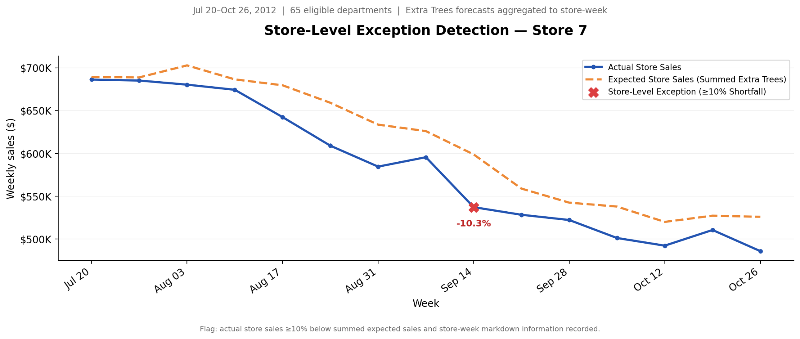
Store-Level Exception Detection (10% Threshold)
Store-level analysis identified one exception, while department-level analysis revealed additional sales shortfalls hidden in overall store performance.

Slide 19
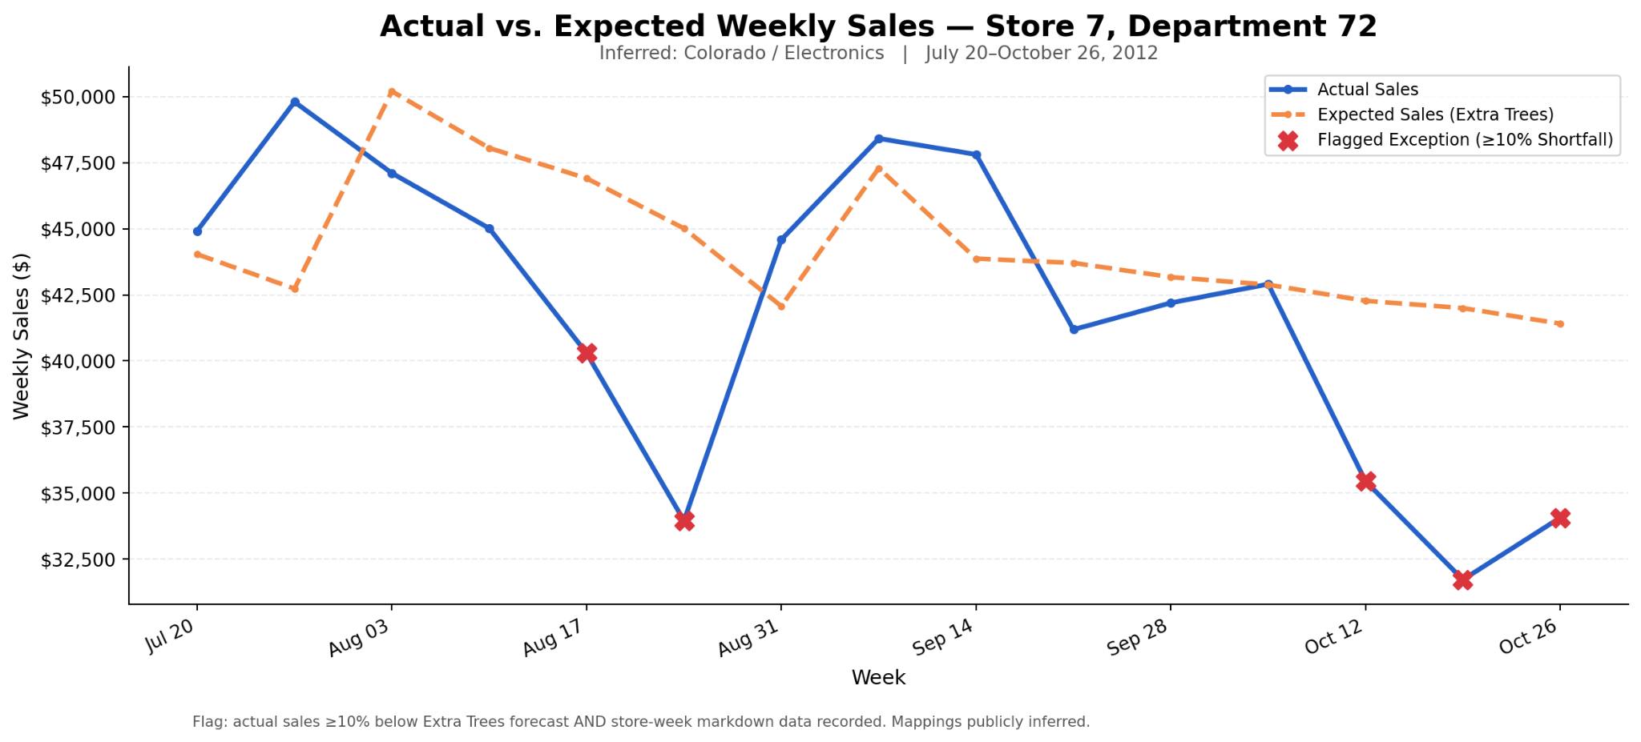
Department-Level Exception Detection (10% Threshold)
Notes:
“This graph shows actual versus expected weekly sales for Store 7, Department 72, which is inferred to be Electronics, from July to October 2012.
The blue line represents actual sales, while the orange dashed line represents expected sales predicted by our Extra Trees model.
The red X markers highlight potential exceptions where actual sales were at least 10% below expected sales during weeks with recorded markdown information.
We identified five exceptions out of 15 weeks in this test period.
For example, on August 24, actual sales were approximately $34,000, compared with expected sales of $45,000, representing a 24.6% shortfall.
These results suggest that certain weeks experienced substantial underperformance relative to historical sales expectations.
However, these exceptions do not necessarily indicate ineffective markdowns. Further investigation is needed to understand the possible causes and business significance.”
We initially considered detecting exceptions at the store level, but found that aggregating sales can hide meaningful department-level underperformance. For example, on August 24, Store 7 was only 7.61% below expected sales, while Department 72 was 24.6% below expected. Therefore, we're using Store × Department × Week forecasting to identify granular exceptions, while aggregating predictions to provide a store-level overview.

Slide 20
Exception Detection Comparison
Extra Trees
8-Week Moving Averages
Week | Actual Sales | Expected Sales | Deviation
Aug 17, 2012 | $40,291 | $46,904 | −14.1%
Aug 24, 2012 | $33,958 | $45,010 | −24.6%
Oct 12, 2012 | $35,450 | $42,273 | −16.1%
Oct 19, 2012 | $31,729 | $41,997 | −24.4%
Oct 26, 2012 | $34,076 | $41,409 | −17.7%
Week | Actual sales | Expected sales | Deviation
Aug 17, 2012 | $40,291 | $46,343 | −13.1%
Aug 24, 2012 | $33,958 | $46,429 | −26.9%
Oct 12, 2012 | $35,450 | $42,667 | −16.9%
Oct 19, 2012 | $31,729 | $42,061 | −24.6%
Oct 26, 2012 | $34,076 | $41,783 | −18.4%
Both methods identified the same 5 exceptions using the preliminary 10% sales-shortfall threshold.
August 24 showed the largest percentage shortfall (Extra Trees: −24.6%; 8-Week MA: −26.9%).
Consistent exception flags across methods support further business investigation.

Slide 21
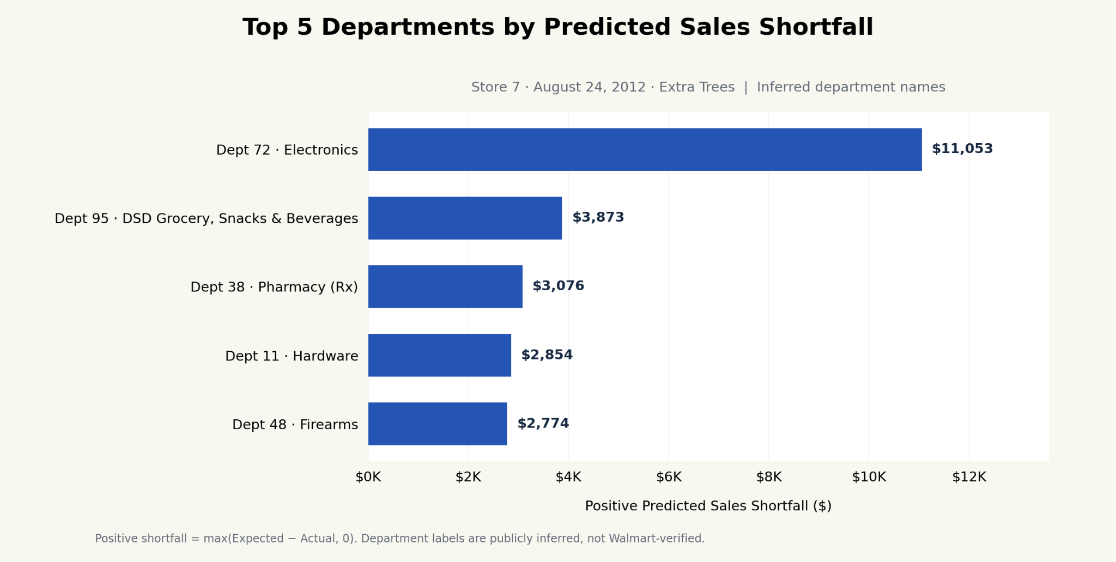
Department-Level Sales Shortfall Analysis
Selected for AI/RAG Investigation
Calculation: Positive Shortfall = max(Expected Sales − Actual Sales, 0)
Aggregation: Sum positive shortfalls across departments and rank by dollar contribution.
Notes:
We calculated each department's predicted sales shortfall by subtracting actual sales from expected sales. We only included positive shortfalls and ranked departments by their dollar contributions.
On August 24, Department 72 had the largest shortfall at approximately $11,000, representing 19.2% of the total positive shortfalls across eligible departments in Store 7.
This helps us prioritize Department 72 for further investigation.
After comparing expected and actual sales across departments, we ranked them by their predicted dollar shortfalls.
Department 72, inferred to be Electronics, had the largest shortfall at approximately $11,000, accounting for 19.2% of total positive department shortfalls.
We selected this department for further AI-assisted investigation to explore possible reasons for its underperformance.

Slide 22
AI/RAG Handoff
Handoff Layer | Your Case Output | Purpose
Detection Results | Store 7, Dept 72, Aug 24, 2012 | Identify flagged observation
Sales Shortfall | −24.6% ($11,053) | Quantify underperformance
Department Contribution | 19.2% of gross shortfalls | Prioritize investigation
Markdown Context | Store-week data recorded | Examine available promotion information
Macro Indicators | Fuel, CPI, unemployment, temperature | Investigate external conditions
RAG Evidence | Historical reports and reviews | Explore possible explanations
Structured Detection Output: Extra Trees provides expected sales, deviations, and department-level exceptions.
AI Agent Handoff: Pass selected exceptions, department contributions, and contextual indicators for further investigation.
Human Review: Present evidence, limitations, and recommended actions through the proposed Streamlit dashboard.
Sample Output: Extra_Trees_AI_RAG_Handoff_Store7_Dept72.json

Slide 23
Anomaly Detection
Unsupervised Multi-Store Screening and Decomposition
Across 45-Store Universe (Complementing Supervised Department Benchmarking)

Slide 24
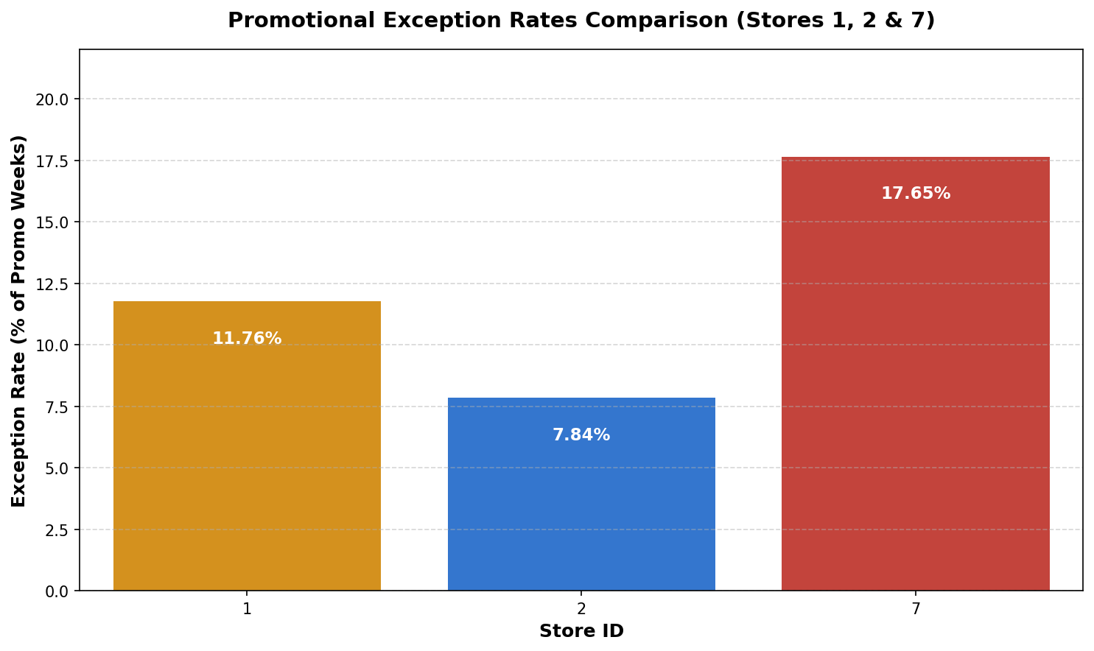
Retail Exception Detection & Exploratory Data Analysis
Quantitative Root-Cause Isolation Across 6,435 Store-Weeks & Multi-Store Validation
Dimension | Universe Scope | Test Slice
Stores Evaluated | 45 Stores | Stores 1 & 2
Time Horizon | 143 Weeks | 51 Active Weeks
Primary Units | 6,435 Store-Weeks | 102 Store-Weeks
Active Markdowns | 2,295 (35.7%) | 102 (100.0%)
Identified promotional exceptions where active markdowns failed to sustain expected sales volume.
Engineered dual-engine detection combining a 4-Week Moving Average with an Isolation Forest.
Decomposed deficits dynamically across all departments to feed downstream AI investigation agents.
* Primary Data: train.csv (421,570 rows), features.csv, and stores.csv

Slide 25



METHODOLOGICAL FRAMEWORK
Dual-Engine Anomaly Detection Architecture
Pairing rolling operational baselines with unsupervised multivariate machine learning
2. Multivariate ML Engine
1. Multi-Window Baselines
Isolation Forest: Unsupervised outlier isolation across sales, markdown spend, fuel price, CPI, unemployment, and temperature.
3. Dynamic Pareto Engine
Trailing Moving Averages: 4-week and 8-week rolling averages lagged by 1 week to eliminate forward data leakage.
All-Department Sweep: Automatically evaluates all 80+ department categories in each flagged store without manual pre-filtering.
Operational Target: Establishes expected run-rate and isolates transient weekly drops from structural quarterly slumps.
Multidimensional Context: Flags weeks where sales are abnormal given positive macro conditions and heavy promotional investment.
Culprits vs Buffers: Ranks largest dollar deficit contributors alongside resilient staple categories cushioning store losses.
Trigger: Active Promo + Sales ≤ -10%
Convergence: Independent ~10% Anomaly Rate

Slide 26

TEST SLICE VALIDATION · STORES 1 & 2
Dual-Store Anomaly Detection & Category Shortfall Concentration
Tracking 4-week moving average deviations alongside cumulative department deficits (Nov 2011 – Oct 2012)
STORE 1 & STORE 2 EXCEPTION TRAJECTORY
TOP 10 DEFICIT DEPARTMENTS (STORES 1 & 2)
Actual
4-Wk MA
Anomaly
Cumulative Drag: $2.14M
Store 1 (Type A · 151k sq ft)
Jan Exceptions: -18.9% to -20.5%
Dept 7
$512.4k
Dept 72
$255.1k
Dept 92
$226.0k
Dept 5
$203.1k
Dept 82
$187.8k
Store 2 (Type A · 202k sq ft)
Post-Holiday Drop: -$655.9k (-26.7%)
Dept 18
$184.9k
Dept 1
$173.2k
Dept 23
$170.1k
Dept 9
$124.9k
Dept 55
$121.8k
Post-Holiday Clustering: Anomalies tightly cluster in January 2012 due to baselines inflated by peak December holiday sales volume ($2.5M–$3.2M).
Pareto Deficit Concentration: The top 2 departments (Dept 7 & Dept 72) generate over $767,500 (35.8%) of total cumulative losses across all exception weeks.
Promotional Resistance: Active clearance markdowns ($17k–$105k weekly) failed to stimulate post-holiday demand, proving zero discount elasticity.
Stores 1 & 2 Multi-Week Attribution
Workstream 1: Dual-Store Performance & Pareto Deficits
Shortfalls reflect genuine consumer purchase drops, not accounting chargebacks or mass merchandise returns.
Quality Verification & Return Auditing

Slide 27
CHAIN-WIDE RESULTS
Quantifying Promotional Exceptions Across the Chain
Evaluating detection sensitivity across 6,435 historical store-weeks
TOTAL STORE-WEEKS EVALUATED
6,435
Detection Sensitivity Across Baseline Models
143 historical weeks across all 45 Walmart locations
4-Week Moving Average (Short-Term Momentum)
235 Exceptions (10.2%)
ACTIVE PROMOTIONAL UNIVERSE
Captures immediate operational sales drop-offs and promotional friction.
2,295
52-Week YoY Seasonal Lag (Holiday-Adjusted)
110 Exceptions (4.8%)
Weeks recording active markdown dollars (35.7% of total)
Isolates annual structural failures after adjusting for seasonal holiday surges.
High-Confidence Stores 1 & 2 Test Slice
10 Exceptions (9.8%)
4-WEEK MA EXCEPTIONS (≥ 10% DROP)
235 (10.2%)
Mirrors the chain-wide ~10% frequency, validating the sponsor test scope.
Clearance investments failing to sustain expected run-rate

Slide 28


STORE CLUSTER ANALYSIS
Market Asymmetry: Format Size Dictates Exception Risk
Comparing markdown vulnerability across store formats and square footage
High-Exception Markets (Supercenters)
Resilient Markets (Compact Formats)
Profile: Large Type A Supercenters (>200,000 sq ft) such as Stores 2, 4, 31, and 32.
Profile: Type B & C Formats (37,000 – 45,000 sq ft) such as Stores 3, 5, 33, and 44.
Exception Rate: 18% – 25% of promotional weeks experience severe ≥ 10% shortfalls.
Exception Rate: Under 4% of promotional weeks breach exception thresholds.
Vulnerability: Large footprints depend heavily on seasonal discretionary merchandise (toys, tech, apparel) that collapse post-holidays.
Stability: Revenue anchored in grocery staples and consumables with inelastic demand and steady foot traffic.
Key Risk: Severe clearance margin destruction
Key Strength: Predictable baseline sales velocity
Cross-Store Robustness
Workstream 1: Format & Footprint Comparisons

Slide 29
PRIMARY BENCHMARK CASE STUDY
Store 2 on January 6, 2012: Post-Holiday Clearance Collapse
Selected as the anchor quantitative exception to fuel multi-agent root-cause isolation
Baseline Inflation Dynamic
The trailing 4-week baseline was heavily elevated by peak December holiday sales ($2.6M+ weekly sales). Consumer spending stalled post-New Year.
CRITICAL FINANCIAL DEFICIT
-$655.9k
(-26.7%)
Promotional Inefficiency
Actual weekly revenue dropped to $1,799,520 against an expected 4-week baseline of $2,455,471 despite deploying $52,955 in promotional markdowns.
Slashed prices across MarkDown1 ($25.3k) and MarkDown2 ($24.0k) failed to stimulate post-holiday demand, proving zero discount elasticity.
Store 2 · Type A Supercenter
Footprint: 202,307 sq ft
Dual Model Convergence
Breached both the -10% statistical threshold and the multivariate Isolation Forest anomaly boundary, establishing high investigative confidence.
Case Study Analysis
Workstream 1: Primary Promotional Exception

Slide 30
ROOT-CAUSE CONCENTRATION · STORE 2
Dynamic Pareto Shortfall: 5 Departments Drive 43.2% of Deficit
Sweeping all 80+ department categories to isolate primary culprits and demand buffers
TOP 5 DEFICIT CULPRITS (CONTRIBUTING $283,426)
RESILIENT DEMAND BUFFERS (BEAT BASELINE)
Dept ID | Actual | Expected | Dollar Deficit | Share
Dept 7 | $19,059 | $128,557 | -$109,498 | 16.7%
Dept 72 | $58,837 | $116,761 | -$57,925 | 8.8%
Dept 5 | $24,429 | $65,737 | -$41,308 | 6.3%
Dept 82 | $22,641 | $63,023 | -$40,382 | 6.2%
Dept 18 | $11,131 | $45,444 | -$34,313 | 5.2%
Dept 40
+$7,520 Surplus
Dept 38
+$7,074 Surplus
Dept 13
+$5,113 Surplus
Proof of category insulation: Essential non-discretionary categories sustained store cash flow while discretionary demand collapsed.
Root-Cause Attribution

Slide 31
DATA INTEGRITY · RECURRING DRIVERS
Offending Department Frequencies & Return Validation
Verifying systemic promotional drag and ruling out return distortions
RECURRING ANOMALY TRIGGER FREQUENCY
Tracking which department numbers trigger the most promotional exceptions across Stores 1 & 2:
RETURN SPIKES & DATA INTEGRITY AUDIT
Auditing negative weekly sales (Weekly_Sales < 0) to rule out return spikes or accounting adjustments:
Dept 7
Ranked #1 Culprit in 60% of Exceptions
Negative Sales Records (Stores 1 & 2)
0 Instances
Dept 72
Top-3 Driver in 80% of Exception Weeks
Chain-Wide Negative Record Share
< 0.3% of Records
Depts 5 & 82
Secondary Clearance Bottlenecks
Shortfalls reflect genuine consumer purchase drops, not accounting chargebacks or mass merchandise returns.
Exceptions are not random: Promotional drag is systematically concentrated in high-ticket discretionary departments.
Quality Verification & Return Auditing

Slide 32
CONFIRMATORY TESTING
Promotional Spend Allocation & Macro Headwind Validation
Dissecting markdown channel efficiency and statistically ruling out external shocks
MARKDOWN SPEND PROFILE (STORE 2: $52,955)
MarkDown1 (Clearance / Rollback)
$25,296 (47.8%)
MACROECONOMIC Z-SCORE TEST (ISOLATING EXTERNAL SHOCKS)
Macro Variable | Observed | Mean | Z-Score
Fuel Price | $3.16/gal | $3.41 | -0.84 σ
CPI | 219.35 | 217.80 | +0.42 σ
Unemployment | 7.06% | 7.32% | -0.71 σ
MarkDown2 (Event / Seasonal Cut)
$24,045 (45.4%)
MarkDown3, 4 & 5 (Supplier Promos)
$3,614 (6.8%)
- Over 93% of discount dollars were deployed into aggressive clearance and post-holiday price cuts
- Confirms massive promotional investment with zero demand elasticity.
Macro Shock Ruled Out: All macro variables remain within ±1.0 standard deviations; the shortfall is internal merchandising failure, not an economic shock.
Economic Context & Promo Depth
Workstream 1: Promotional Spend Allocation

Slide 33
SYSTEM INTEGRATION · AGENT CONTRACT
Automated JSON Payload Powers Downstream AI Agents
1. ANOMALY SCORER
2. PARETO DRILL-DOWN
3. MACRO & RAG AGENT
4. STREAMLIT DASHBOARD
Ingests -$655.9k shortfall and -26.7% deviation to trigger priority investigation status.
Receives Dept 7 and Dept 72 deficit shares, isolating 43.2% category drag instantly.
Confirms stable gas/CPI, directing ChromaDB to query Q4 FY2012 SEC 10-K post-holiday text.
Displays verified facts and category metrics for human retail analyst review and sign-off.
✓ Deliverable Status: Complete & Validated
Handoff Artifact: primary_anomaly_payload.json

Slide 34








AI AGENT · WHY IT MATTERS
Why an AI Agent, Not Just a Dashboard
A dashboard shows what happened. Analysts still need to know why.
DASHBOARD ALONE
WITH THE AI AGENTS
Shows Store 7 Electronics down 24.6%
Checks if the drop is a one-off or a pattern, and how other stores did
Analyst searches reports manually
Searches 59 Walmart, Federal Reserve and NRF reports from the same quarter and region
No sense of how reliable a number is
Tags every claim with its evidence type and confidence, and checks its own numbers and quotes
Raw numbers only
Weighs possible explanations and recommends a review
Same flag, two different answers. The agents ran on three real exceptions: one needs review, two are explained.
Store 7: Needs review
Store 2: Explained
The agent does not replace the analyst. It does the first round of investigation, live in our dashboard.
AI Agent Workstream · Motivation
Notes:
A dashboard can tell us that Electronics in Store 7 dropped 24.6 percent. It cannot tell us whether that is unusual, how other stores did, or what Walmart and the Federal Reserve were reporting that quarter. Our agents do that first round of investigation, live. They check whether the drop is a one-off, how other stores did, search 59 original reports from the same quarter and region, tag every claim with its evidence type and confidence, and check their own numbers and quotes. The agent does not always find a problem. On the three real exceptions we ran, one needs review and two are explained by timing. The agent does not replace the analyst. It lets the analyst start from evidence.

Slide 35
AI AGENT · KNOWLEDGE SOURCES
AI Agent Knowledge Sources: What Is Loaded
59 original reports are cut into 6,560 chunks and stored in a 60.7 MB vector store; sales data is read directly
Source | What it tells the agent | Files | Chunks | Type
Walmart sales data (Kaggle) | Weekly sales by store and department with markdowns, fuel, temperature, CPI, unemployment | 3 CSV files · 421,570 rows | read by pandas | Direct structured evidence
Store & department mapping | What the anonymized codes most likely mean, rated High / Medium / Unresolved | 45 stores · 81 depts | lookup tables | Inferred mapping
Walmart earnings releases | Company-wide comp sales, traffic and ticket each quarter (FY11 Q1 – FY13 Q3, plus 2 comp-sales sheets) | 13 files | 369 | Walmart-level context
Walmart earnings call transcripts | Management commentary by category, e.g. electronics deflation or Easter timing | 11 files | 1,008 | Walmart-level context
Walmart 10-K and annual report | Merchandise units, seasonality, strategy and risks (FY2010 – FY2013) | 8 files | 1,462 | Walmart-level context
Federal Reserve Beige Book | What retailers in each Fed district reported, split by district (national + 12) · Jan 2010 – Nov 2012 | 24 files | 3,706 | Regional / macro context
NRF holiday forecast | Expected holiday spending (2010, 2011, 2012 forecasts) | 3 files | 15 | Regional / macro context
EIA fuel prices | Weekly gas prices by region; used to infer each store's region | 10 weekly series | lookup tables | Regional / macro context
Every claim the agent makes is tagged with one of four types: direct data, inferred mapping, Walmart-level or regional context.
AI Agent Workstream · Sources
Notes:
These are the sources the agents use, and they are all loaded, not planned. The sales data, 421,570 rows, is read directly by the Evidence Agent. The mapping tables tell the agents what the anonymized codes most likely mean, with a confidence level; we are clear that they are publicly inferred. The text sources are cut into chunks and stored in ChromaDB: 59 original reports, 6,560 chunks. Walmart's own earnings releases, call transcripts and 10-K filings give company-level context for eleven quarters. The Beige Book is the largest source, 24 editions, and we split each edition by Fed district so a chunk always knows which district it describes. NRF adds the holiday forecasts and EIA fuel prices are used to infer each store's region. Every claim the agent makes is labeled with one of four types, so it is clear what is fact and what is context. No competitor or third-party data is used.

Slide 36











AI AGENT · ARCHITECTURE
AI Agent Architecture: What Runs Today
A LangGraph orchestrator runs two agents in parallel; a reasoning agent writes the report; Streamlit streams it live
Evidence Agent
pandas over the Kaggle sales data
Anomaly Payload
Orchestrator
Reasoning Agent
Dashboard + Analyst
421,570 rows · 26 ms
3 formats accepted: Extra Trees, store-week, baseline
LangGraph: 6 nodes; sends both tasks at once
Rules decide the verdict; a free LLM writes the text
Streamlit: live trace, follow-up chat, quality checks
RAG Agent
3 example cases
2 agents in parallel
rules 1 ms + LLM
4 of 6 checks automatic
ChromaDB over the original reports
6,560 chunks · 4.1 s
Follow-up questions loop back to the orchestrator
Built with
Python + pandas
LangGraph
ChromaDB
OpenRouter free LLM
Streamlit
GitHub
Store 7, median of 3 runs: 12 s end to end with the LLM writer (about 4 s with rules only).
AI Agent Workstream · Architecture
Notes:
This is what is actually running today. A payload from the anomaly team arrives in one of three shapes: the Extra Trees store-department-week hand-off, the store-week payload from the multi-store screening, or a baseline detection. We normalize all three into one internal payload. A LangGraph orchestrator with six nodes sends two tasks at the same time. The Evidence Agent runs pandas checks over the 421,570 sales rows in about 26 milliseconds. The RAG Agent searches 6,560 chunks in ChromaDB in about 4 seconds. The Reasoning Agent applies rules to decide the verdict and confidence, and a free LLM through OpenRouter writes the plain-language explanation; if the model is rate-limited the rules write it instead. Streamlit shows the agents working live, then the factors, the evidence, and automatic quality checks, and the analyst can ask follow-up questions that go back to the orchestrator. End to end it takes about 12 seconds for Store 7 with the LLM writer, and about four seconds with rules only.

Slide 37
AI AGENT · RAG AGENT
RAG Agent: Strategy and Numbers
Filter by time and place first, then search by meaning, then re-rank by the best-matching sentence
STRATEGY
IN NUMBERS
1
Chunk the originals
About 900 characters per chunk, cut at sentence boundaries, 150-character overlap. Table and number noise dropped (299 chunks). Beige Books split by Fed district.
59
6,560
reports loaded
chunks embedded
2
Embed and store
Each chunk keeps publisher, evidence type, Fed district, report period and publish date as metadata in ChromaDB.
60.7 MB
124
vector store on disk
words per chunk on average
3
Plan the query
2 to 4 short questions per case: category trend, consumer demand, calendar event, fuel or weather signal.
STORE 7 SEARCH FUNNEL
6,560 chunks in the store
4
Filter before searching
Time: report covers the week, came out in the 3 weeks before, or its period just ended. Place: the store's Fed district or national.
705 after time + region filter (7 reports)
5
Search and re-rank
Top 25 chunks per query, then 30 best re-scored by their best sentence (45% chunk, 55% sentence, plus keywords and a local-district boost). Max 2 chunks per report; each keeps one verbatim quote.
42 candidates from 2 queries
6 passages returned · 4.1 s
Embeddings: all-MiniLM-L6-v2 (ONNX, 384-dim) · ChromaDB HNSW index, cosine distance · built in 133 s from the original files.
AI Agent Workstream · RAG Agent
Notes:
Here is how the RAG agent works, strategy first. We cut the original reports into chunks of about 900 characters at sentence boundaries with a small overlap, drop table and number noise, split Beige Books by Fed district, and embed every chunk with a 384-dimension model into ChromaDB, with the publisher, evidence type, district, period and publish date as metadata. At question time the agent plans two to four short queries: the category trend, consumer demand, a calendar event if there is one, and a fuel or weather signal if there is one. The key design choice is to filter before searching: a report must cover the week, have come out in the three weeks before, or just have ended, and it must be national or from the store's own Fed district. A 2014 report can never be retrieved for a 2012 anomaly. Then it takes the top 25 chunks per query by meaning and re-scores the 30 best by their single best-matching sentence, because a long chunk can match for the wrong reason. At most two chunks per report, and each keeps one verbatim quote. The numbers: 59 reports, 6,560 chunks, a 60.7 megabyte store. For Store 7 the search narrows 6,560 chunks to 705 after the filter, 42 candidates, and 6 passages returned in about 4 seconds.

Slide 38
AI AGENT · EVIDENCE AGENT
Evidence Agent: Strategy and Numbers
Six pandas checks, each answering one question an analyst would ask, run on the sales data in milliseconds
STRATEGY
IN NUMBERS
1
Store vs. department
Is the whole store down, or just this department? (store total vs. last year that week)
421,570
6
sales rows scanned per run
checks per case
2
Quarter trend
One-off week or a pattern? (quarter vs. last year, weeks below last year)
15–29 ms
5 of 5
3
Regional peers
How did the same department do in other stores of the region this quarter?
median time per run
key numbers re-verified from raw files (Store 7)
4
Whole chain
Is every store seeing this? (all 45 stores, same department and quarter)
STORE 7 · ELECTRONICS RESULTS
Rest of the store only −3.3%
Electronics −12.7% this quarter, down 9 of 13 weeks
Colorado peers: −3.6%, +2.8%, +14.2%
All 45 stores: −0.5%
Markdowns 0.6× a normal week; fuel +2.1%
No holiday that week
5
Markdowns and macro
Markdowns vs. the store's average week; fuel, temperature, CPI, unemployment vs. last year.
6
Calendar
Did a holiday move, or does the baseline hold a holiday peak? Compare six-week totals.
Store-level payloads (Store 2) swap in: baseline contents, same week last year, all-45-store rank, department mix and the next 4 weeks.
AI Agent Workstream · Evidence Agent
Notes:
The Evidence Agent is plain pandas over the 421,570 sales rows, and that is on purpose: every number it gives can be recomputed. Its strategy is six checks that mirror what an analyst would ask. Is the whole store down or just this department? Is it one week or a pattern? How did similar stores in the region do? Is the whole chain seeing it? Did markdowns, fuel or weather change? And did a holiday move, or does the baseline contain a holiday peak? Each run takes 15 to 29 milliseconds. For Store 7 Electronics it finds the rest of the store only minus 3.3 percent, Electronics down 12.7 percent this quarter and 9 of 13 weeks, Colorado peers between minus 3.6 and plus 14.2, the chain at minus 0.5, markdowns at 0.6 times a normal week. For a store-level payload like Store 2 it swaps in checks on what the baseline contains, the same week last year, the rank among all 45 stores, and the department mix. A separate script recomputes the key numbers from the raw files, and all five match for Store 7.

Slide 39
AI AGENT · REASONING AGENT
Reasoning Agent: Strategy and Numbers
Rules decide the verdict and confidence so every claim traces to a number or a quote; an LLM may only rewrite the text
STRATEGY
IN NUMBERS
1
Is it just timing?
A holiday moved, or the baseline holds a holiday peak, AND sales are flat vs. last year, AND other stores dropped the same. Then: Likely explained.
1 + 2
4 to 5
cases: needs review + explained (3 run)
factors per answer
2
Otherwise weigh the factors
Company-wide trend (Walmart quotes), store-specific gap vs. chain and peers, promotions (markdown ratio plus Fed quote), store-wide weakness. Then: Needs review.
5 of 5
5.6 s
quotes found word for word in the sources
LLM writer, median when it answers
3
Rate the confidence
Starts at High and drops for: single-week drop, department or region name not High confidence, no time-aligned report, part of the drop unexplained.
VERDICTS ON THE THREE CASES
Store 7
Electronics
Needs review · Medium
Store 13
Candy & Tobacco
Likely explained · Medium
4
LLM writer (free model)
Rewrites the explanation in plain language. Rejected if it adds any number or quote that is not in the facts; if the free model is rate-limited, the rules write the text.
Store 2
All departments
Likely explained · High
LLM writer: free model via OpenRouter (laguna-s-2.1:free); 5 of 9 runs got an answer, 4 were rate-limited and used the rules, 0 rejected.
AI Agent Workstream · Reasoning Agent
Notes:
The Reasoning Agent decides the verdict with rules, so every claim traces to a number or a quote and the result is testable. Step one: is it just timing? If a holiday moved, or the baseline holds a holiday peak, and sales are flat versus last year, and other stores dropped by the same amount, the verdict is Likely explained. If not, it weighs the factors: the company-wide trend using Walmart's own words, whether this store is worse than the chain and its peers, promotions, and store-wide weakness. That gives Needs review. Then it rates its confidence, which starts at High and drops for a single-week drop, a department name that is not high confidence, missing time-aligned reports, or a part of the drop left unexplained. On our three cases the verdicts are one Needs review and two Likely explained, each with four or five factors, and all 5 quotes it used were found word for word in the original source files. On top of that, a free LLM through OpenRouter rewrites the explanation in plain language in about 5.6 seconds, using about 1280 tokens in and 149 out. Its text is rejected if it adds any number or quote that is not in the facts. In our last nine runs, 5 got an answer, 4 were rate-limited by the free tier and fell back to the rules, and none were rejected. The factor tables on these slides are the rules; the plain-language paragraph in the app is the LLM.

Slide 40
AI AGENT · ORCHESTRATOR · REQUEST FLOW
Orchestrator and Request Flow: Live Trace
One request followed through the LangGraph graph; milliseconds are medians of 3 runs on Store 7
Request: “Why did Electronics drop at Store 7 in the week ending Aug 24, 2012?”
3
Evidence Agent
5
Reasoning Agent
Electronics −12.7% this quarter; Colorado peers −3.6% to +14.2%
Needs review · Medium. Rules decide in 1 ms; the LLM writes the plain-language text
1
Payload
2
Orchestrator
Store 7 · Electronics
$34.0K vs. $45.0K (−24.6%)
Reads the signals, plans 2 queries, sends both tasks at once
26 ms
7,677 ms
4
RAG Agent
6
Checks + Analyst
2 ms
1 ms
705 chunks pass the filter; 6 passages returned
4 of 6 checks pass automatically; analyst confirms or asks a follow-up
4,110 ms
42 ms
Follow-up loops back to the orchestrator · total 11.8 s
Follow-ups are routed to one of 8 intents; “How did Store 41 do?” calls an Evidence lookup tool.
AI Agent Workstream · Request Flow
Notes:
Here is one request through the orchestrator, with the real timings. The question is why Electronics dropped at Store 7 in the week ending August 24, 2012. The payload says 34 thousand dollars against 45 thousand expected. The orchestrator, which is a LangGraph graph, reads the calendar, fuel and weather signals, plans two queries for the RAG agent, and sends both tasks at the same time. The Evidence Agent finishes in 26 milliseconds with Electronics down 12.7 percent this quarter. The RAG Agent takes about 4 seconds because it embeds and re-scores sentences, and returns six passages from 705 chunks that passed the time and region filter. The Reasoning Agent decides in about a millisecond with rules: Needs review with medium confidence. Most of its time here is the free LLM writing the plain-language text, which can be slower or rate-limited, in which case the rules write it. Then four of the six quality checks run automatically. Total about 12 seconds. If the analyst asks a follow-up, the orchestrator routes it to one of eight intents; asking how Store 41 did calls an Evidence lookup tool and answers with Store 41's real numbers.

Slide 41

AI AGENT · EXAMPLE 1 · NEEDS REVIEW
Anomaly Example: Store 7, Electronics (Colorado)
The ML model detects the anomaly; the agents find the possible factors (this is the live agent output)
ANOMALY DETECTED
by the Extra Trees model
Store
7 · Colorado
Department
72 · Electronics
Week ending
Aug 24, 2012
Actual vs. expected
$33,958 vs. $45,010
Gap
−24.6%
Possible factor | What the evidence says
Falling electronics prices | Walmart reports: “Within entertainment, deflation continues to impact sales growth in electronics.” (Walmart FY13 Q2 earnings call transcript, 2012-08-16). Across all 45 stores, Electronics was −0.5% this quarter, so company-wide trends explain only part of this store's −12.7%.
A problem at this store | Sales data: Store 7 Electronics fell −12.7% this quarter (down 9 of 13 weeks), while other Colorado stores held up much better: Store 16 −3.6%, Store 41 +2.8%, Store 32 +14.2%. Likely the store itself: stock, product range or local competition.
Fewer promotions during back-to-school | Sales data: Store 7 ran fewer markdowns than usual that week (about 0.6× a normal week), while the Federal Reserve reported “Home furnishings, clothing and back-to-school items sold well, while sales of high-end jewelry were weaker.” (Kansas City Fed (10th District)).
Ruled out | No holiday that week, fuel prices barely changed (+2.1%), normal weather, and the rest of the store was only −3.3%.
Bottom line: Walmart reported only a small company-wide decline in this category, but Store 7 Electronics fell −12.7% this quarter. Falling prices explain a small part; most of the drop is specific to Store 7.
Needs review · Medium
Same case and same text as the live Streamlit app.
AI Agent Workstream · Example
Notes:
Here is the first example, and it is exactly what our live Streamlit app produces. The Extra Trees model flagged Store 7 Electronics in Colorado for the week ending August 24, 2012: about 34 thousand dollars against 45 thousand expected, a 24.6 percent gap. The agents found three possible factors. Walmart's own earnings call says deflation continues to impact electronics, but across all 45 stores Electronics is only down half a percent, so company-wide prices explain only part. Our sales data shows other Colorado stores held up much better, so the problem is likely at Store 7 itself. Store 7 also ran fewer markdowns than usual during back-to-school, when the Kansas City Fed said back-to-school items sold well. A holiday, fuel, weather and a whole-store slump are ruled out. The agents say Needs review with medium confidence, because the drop is proven but the cause is only partly explained.

Slide 42



AI AGENT · EXAMPLE 2 · LIKELY EXPLAINED
Anomaly Example: Store 2, Texas, Week Ending Jan 6, 2012
Same kind of flag, different answer: $1.80M vs. $2.46M expected (−26.7%), but the agents say it is the Christmas baseline
STORE 2 WEEKLY SALES ($M) · NOV 2011 – FEB 2012
Christmas inflated the baseline
Expected = average of Dec 9–30, including Christmas week (1.8× a typical week). Store 2 is +2.4% vs. the same week last year.
Amber: the 4 weeks averaged into the expected $2.46M. Red: the flagged week.
Every store dropped
All 45 stores: median −25.3%. Store 2 ranks 20th of 45. Last year's same week was −30.9% by the same method.
December-peak departments
Toys, Electronics, Media & Gaming, Impulse, Seasonal: together +2.0% vs. last year.
Strong season, not a slump
Walmart: “successful holiday season”. Dallas Fed: holiday sales strong. Toys −13.8% is worth a look.
Bottom line: Likely not a real problem. The expected number is inflated by Christmas week; compared with last year Store 2 is +2.4% and every store dropped. The detector's "structural slump" flag is not supported. Only Toys is worth a look over the next two weeks.
Likely explained · High
Same case and same text as the live Streamlit app. Payload: store-week format.
AI Agent Workstream · Example
Notes:
The agents do not flag everything. Here is a second example from the multi-store screening, also exactly what the live app shows: Store 2 in Texas, week ending January 6, 2012. Sales were 1.80 million dollars against an expected 2.46 million, minus 26.7 percent. But look at where the expected number comes from: the average of the four weeks before, December 9 to 30, which includes Christmas week at 3.2 million dollars, almost twice a typical week. The amber dots on the chart are those four weeks. Against the same week last year, Store 2 is actually up 2.4 percent, and last year's same week would have been flagged too, at minus 30.9 percent. All 45 stores dropped a median of 25 percent that week, and Store 2 ranks right in the middle. The five biggest shortfalls are Toys, Electronics, Media and Gaming, Impulse and Seasonal, all December-peak departments, together up 2 percent versus last year's same week. Walmart's own call says it was a successful holiday season, and the Dallas Fed describes strong holiday sales. So the verdict is Likely explained with high confidence, and the agents say the detector's structural slump flag is not supported. They still point out one thing worth a look: Toys is 13.8 percent below last year. This is how the agents save analyst time: they say no action is needed, and why.

Slide 43





AI AGENT · EVALUATION
How We Evaluate the Agents: Results So Far
Four of six checks run automatically on every answer, live in the app; two need independent team reviewers
Number accuracy
Auto
Right time and place
Auto
WHERE WE ARE
Store 7 · Electronics
Is every number in the agent's answer correct?
Is every report from the same quarter and the store's region?
4 of 6 passed
Needs review
5 of 5 key numbers recomputed from raw files ✓
Store 7: 6 of 6 passages in the right quarter and district ✓
Store 13 · Candy & Tobacco
Quote accuracy
Main factor agreement
4 of 6 passed
Likely explained
Auto
Team
Store 2 · All departments
Does every quote really appear in the cited report?
Does the agent pick the same main factor a person would?
4 of 6 passed
Likely explained
Store 2: 2 of 2 quotes found word for word ✓
Two reviewers name it independently
2 pending on each case: main factor and confidence need independent team review.
Next: run all six checks on 10 flagged exceptions, then report the pass rate.
Holiday-shift detection
Auto
Confidence check
Team
Does the agent recognize weeks where a holiday moved?
Does the confidence level match the evidence?
Store 13 Easter ✓ · Store 2 Christmas ✓ · Store 7 none ✓
Two reviewers rate it independently
Automatic checks recompute numbers from raw files and look quotes up in the original source files, not in the agent's own data.
AI Agent Workstream · Evaluation
Notes:
To know whether the agents are trustworthy, every answer goes through six checks, and four of them run automatically in the app. The number check recomputes the key numbers from the raw sales files with separate code, so a bug in the Evidence Agent cannot pass its own check. The time-and-place check confirms every report is from the week's quarter and the store's Fed district or national. The quote check looks every quote up word for word in the original source files. The holiday-shift check compares the agent's verdict with what we know about the week: Easter for Store 13, Christmas for Store 2, and no calendar effect for Store 7. On our three cases, four of six checks pass automatically on each. The two pending ones, main factor and confidence, need two team members to judge independently, so we have not claimed them yet. Next we run all six on ten flagged exceptions, six regular and four holiday-shift, and report the pass rate.

Slide 44
Streamlit Dashboard Live Demo

Slide 45
Techstacks
Category | Technology / Tool
Programming | Python (Google Colab & Local Environment)
Data Processing | Pandas, NumPy
EDA & Visualization | Matplotlib, Seaborn
Supervised Learning | Scikit-learn (Extra Trees, Random Forest, Ridge), XGBoost, LightGBM
Unsupervised Learning | Isolation Forest
Statistical Baselines | 4-Week & 8-Week Moving Averages
Model Evaluation | MAE, WAPE, Chronological Validation
AI Agents & RAG | LLM, LangChain, LangGraph, RAG
Interactive Dashboard | Streamlit
Data Storage | CSV, JSON, Google Drive, Local Files
Collaboration | Google , Outlook,

Slide 46
THANK YOU
Any Questions?

